Slide 1
Credit Risk Analysis Batch: DSP 20
Guided By Submitted By:
Arun Upadhy Narendra Solanki
Nikita Tandel Delwin Chungath
Abdul Rahi Shaikh
Tulika Tripathi
Ratnakar Shukla
Madhu Jain

Slide 2
Analytics Approach
Data Understanding, Objective & Analytic tool
Exploratory Data Analysis (EDA) & Data Cleaning
Data Partition & Transformation
Algorithm
Model Building
Testing and Cross-validation.
Final Result.

Slide 3
Data Understanding, Objective & Analytic tool
Business Focus Area: To benefit organization in understanding and decision making for a credit underwriter whether to pass the loan or not through machine learning practice.
Objective: Build a data model that can predict whether the customer would be a good customer or a bad customer. This will help in deciding the loan should be Approved or Rejected.
Analytics Tool: Python

Slide 4
Exploratory Data Analysis (EDA) & Data Cleaning
Total Variables – 73
Total Observations – 855969
Missing value treatement - 21 variable have missing value more than 50 %. (Action taken – Deleted)
Business Logic deletion: 13 variable deleted by business logic.
2 variable i.e. Emp_length and Term we have replaced the data from unorganized data (i.e. extra space, year, years, <1 etc.) to blank
8 variable have missing value,
Object variable treated by Mode
and Integer ,Float variable treated by Mean.

Slide 5
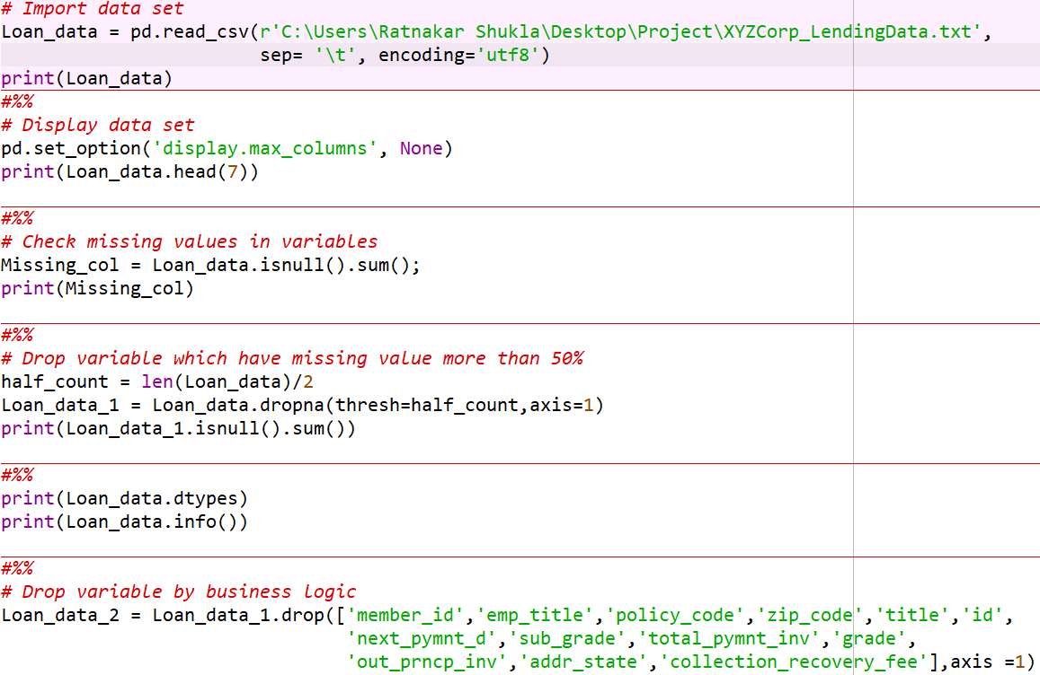
Exploratory Data Analysis (EDA) & Data Cleaning
Coding

Slide 6
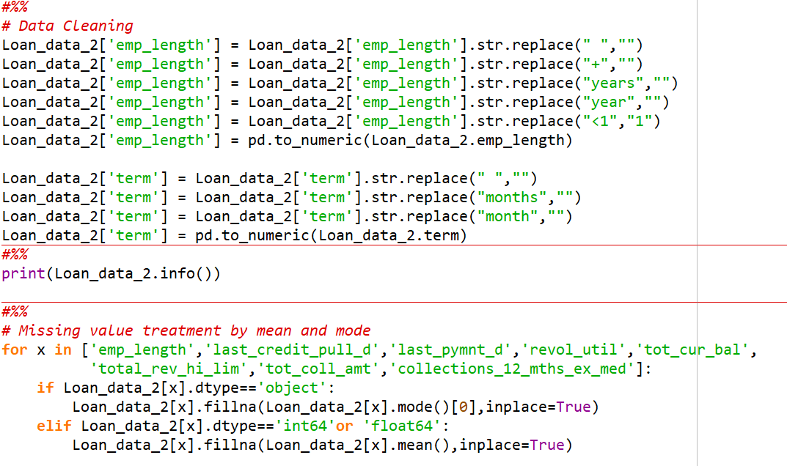
Exploratory Data Analysis (EDA) & Data Cleaning
Coding

Slide 7
Data Partition & Transformation
Data Partition: (As mentioned in the problem statement)
Training data : June 2007 to May 2015
Variable - 39; Observation - 626565
Testing data : June 2015 to Dec 2015
Variable - 39; Observation - 229404
Data Transformation:
Pre-processing using Label Encoder
Scaling

Slide 8
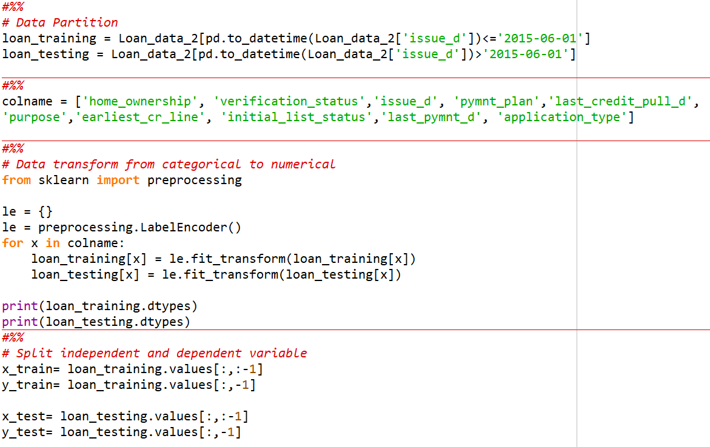
Data Partition & Transformation

Slide 9
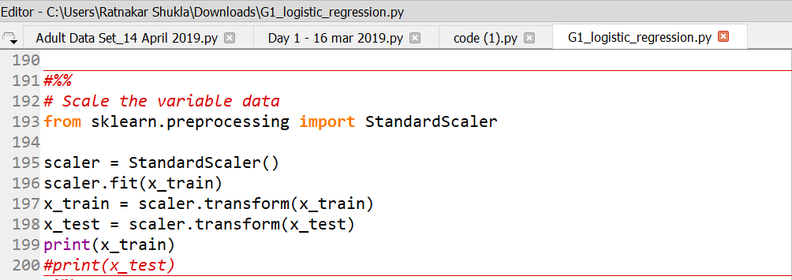
Data Partition & Transformation

Slide 10
Algorithms
Logistic Regression
Support Vector Machine (SVM)
Decision Tree
Ensemble Model

Slide 11
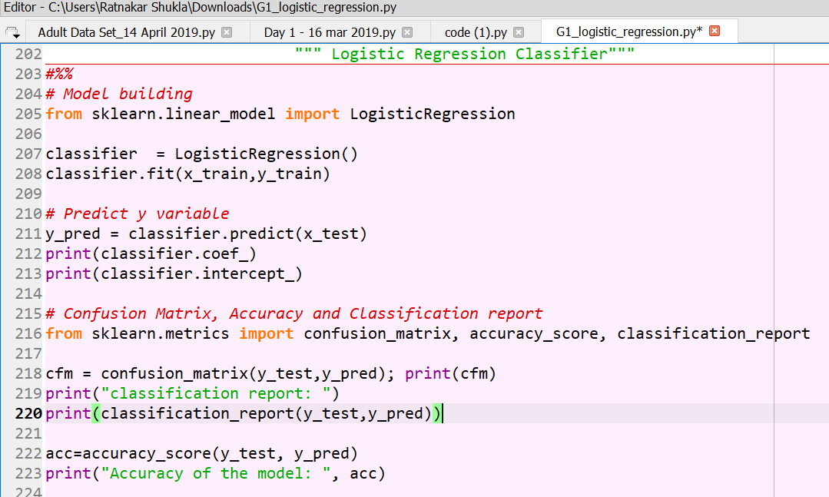
Algorithm – Logistic Regression

Slide 12
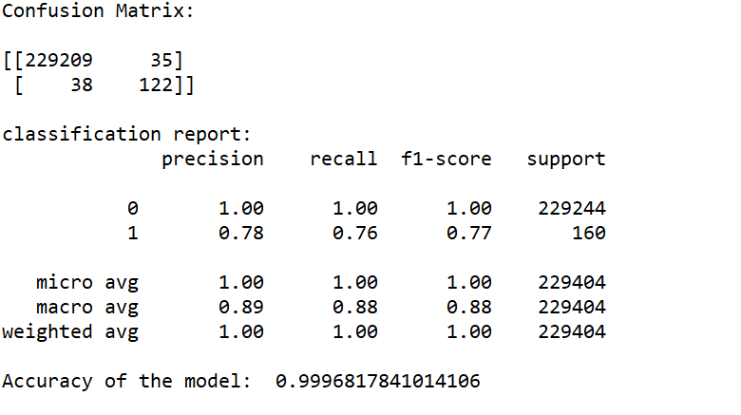
Logistic Regression – Accuracy & Confusion Matrix

Slide 13
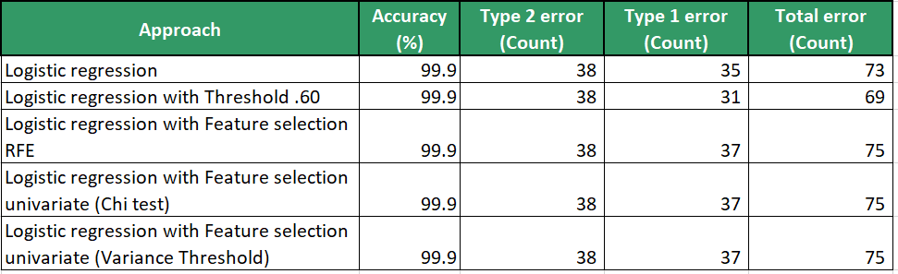
Logistic Regression – Model Comparison

Slide 14
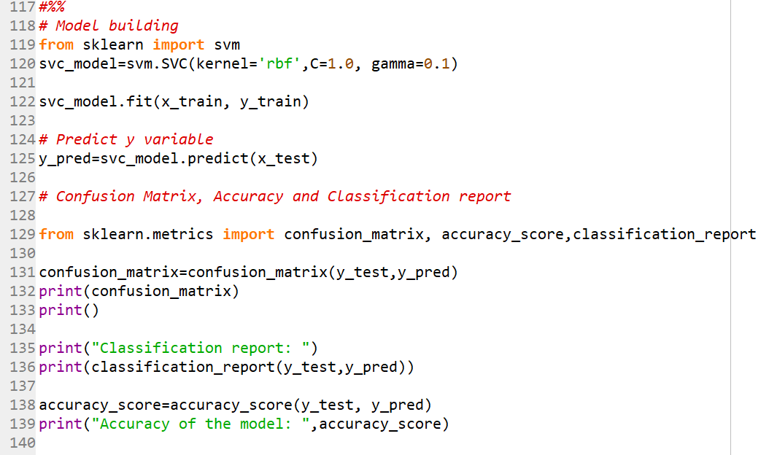
Algorithm – Support Vector Machine (SVM)

Slide 15
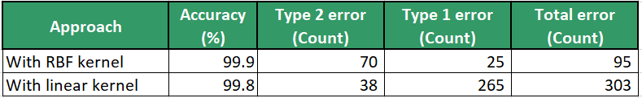
SVM – Model Comparison

Slide 16
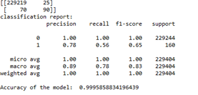
SVM - Accuracy & Confusion Matrix

Slide 17
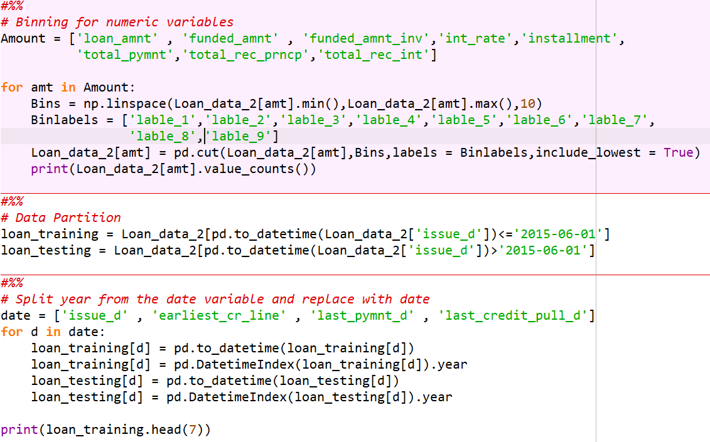
Algorithm – Decision Tree (Binning)

Slide 18
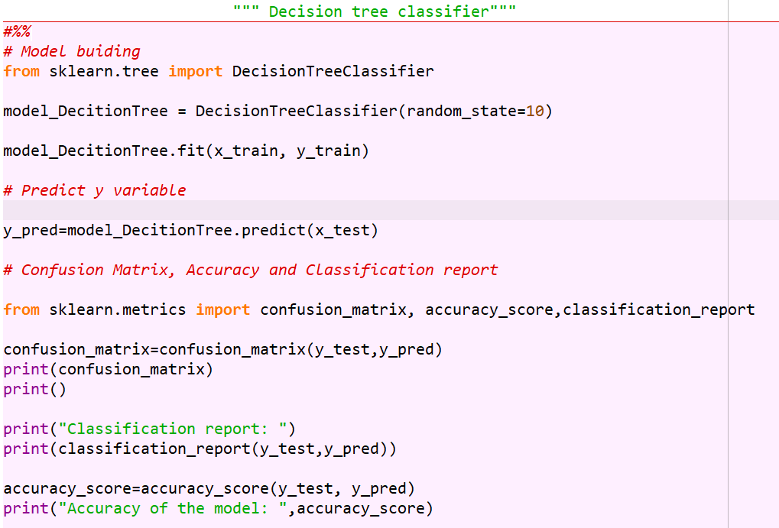
Algorithm – Decision Tree Classifier Model

Slide 19
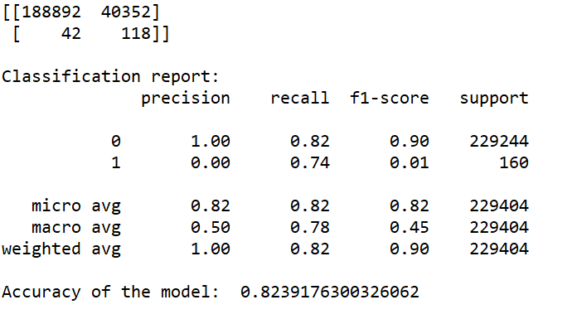
Decision Tree Classifier - Accuracy & Confusion Matrix

Slide 20
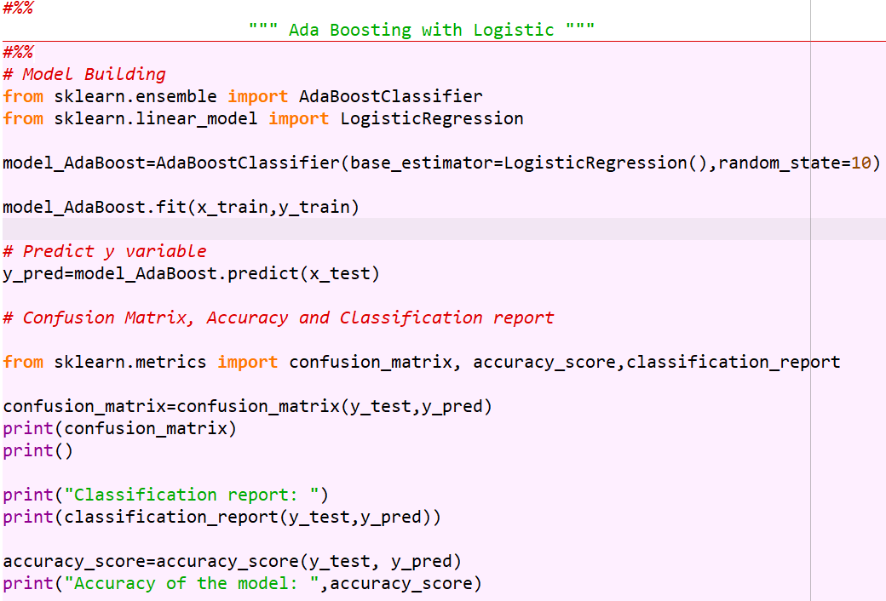
Algorithm – Ada Boosting with Logistic Regression

Slide 21

Ada Boosting with L.R. - Accuracy & Confusion Matrix

Slide 22
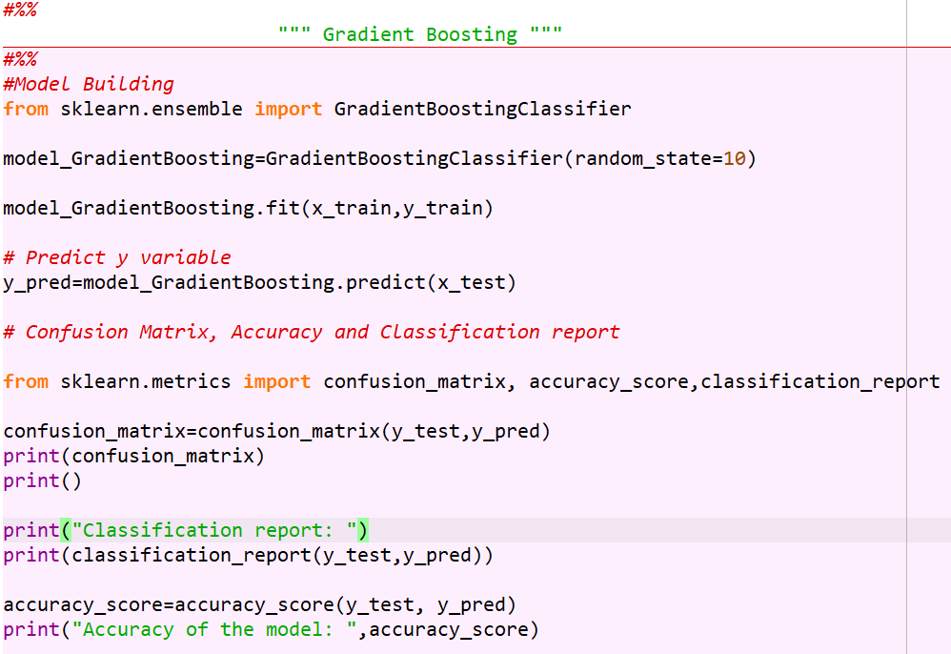
Algorithm – Gradient Boosting Classifier

Slide 23
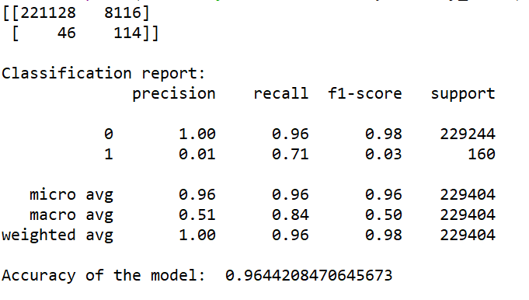
Gradient Boosting Classifier - Accuracy & Confusion Matrix

Slide 24
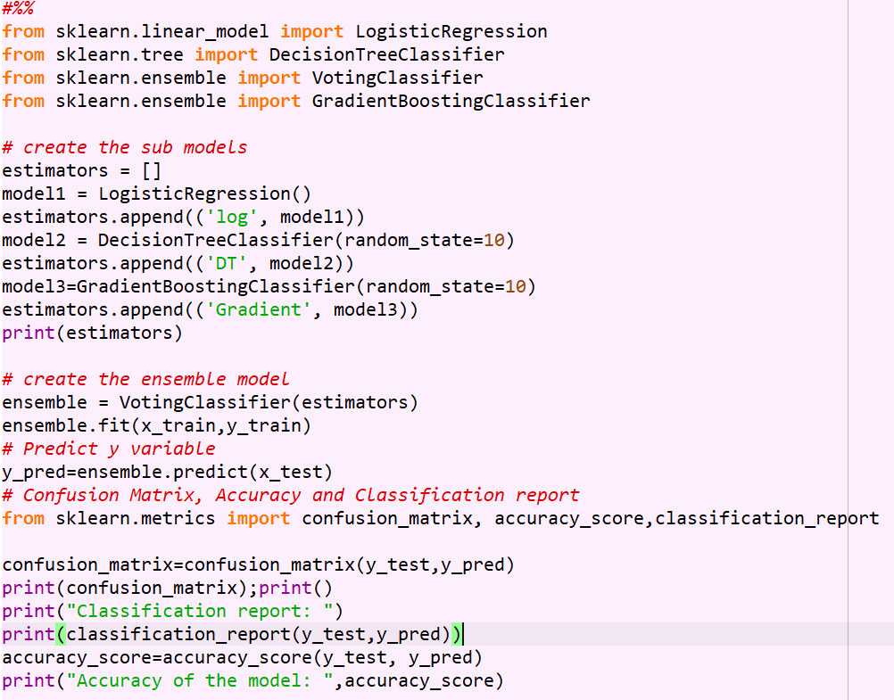
Algorithm – Ensemble Model

Slide 25
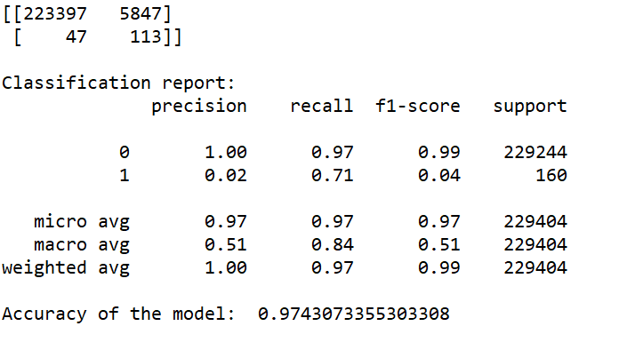
Ensemble Model - Accuracy & Confusion Matrix

Slide 26
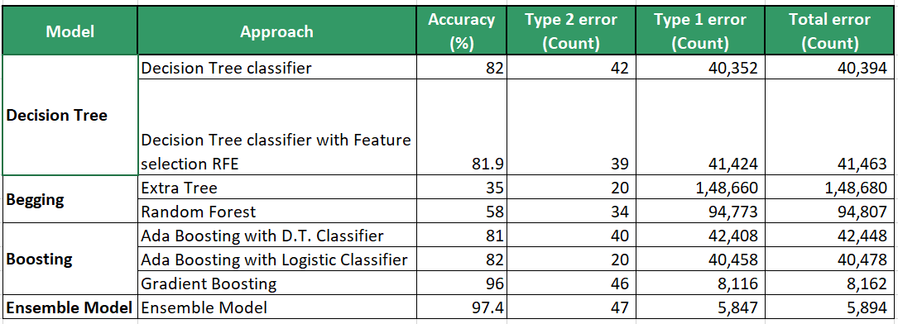
Model Comparison

Slide 27
Final results
Logistic Regression model is the best model for the dataset of XYZ Corporation. We have got the accuracy 99.9% and other error count is 73 (Type 2 error 38 and Type 1 error 35).

